Slide 1
Cash Management
Role of Cash in business operations
Motives of holding Cash
Determinants affecting the Cash
Importance of Cash Forecasting
Importance of Managing Cash Surplus
Need of Good Cash Management MIS

Slide 2
Role of Cash in business operations
Cash is basic input to start a business unit.
Cash in initially invested in fixed assets like plant and machinery, which enable the firm to produce products and generate cash by selling them.
Cash is also needed and invested in working Capital.
The demand for cash is affected by several factors and some of them are within the control of the managers and others are outside the control of the managers.
Cash management thus, in a broader sense is managing the entire business.
Cash management refers to optimizing the benefits and costs associated with holding cash.

Slide 3
Role of Cash in business operations
Unless the cash is put into use, there is no benefit derived out just by holding it.
Further, holding cash without a purpose also costs firm either directly in the form of interest or opportunity income that could be earned out of the cash.
The objective of cash management is to balance the cost associated with holding cash and benefits derived out of holding the cash.

Slide 4
Motives of holding Cash
Why firms hold cash and marketable securities?
Transaction Motive : Money is required to settle customers’ bills, pay salary & wages to workers, pay duties and taxes, etc. (Routine need)
Precautionary or Hedging Motive : It arises due to uncertainty in the future cash need for transaction purpose eg. Non availability of raw material at credit, delay in cash collection, sudden increase in the price of raw material etc. So it is for managing the unseen risk.
Precautionary cash balance is maintained to meet the non-routine needs normally in the form of highly liquid marketable securities (three month or less).

Slide 5
Motives of holding Cash
Speculative Motive : If the firm intends to utilize the opportunities that may arise in the future suddenly, it has to keep some cash balance. For example sudden decrease in the price of raw materials.
Mostly in the case of commodity sector wherein the price of materials fluctuate widely during the different periods like cotton, aluminium, steel, chemicals etc.
Many times for acquiring other firms they keep some surplus cash.

Slide 6
DETERMINANTS OF CASH FLOWS
Internal Factors
i.) Production-related policies:
Ii.) Policies on Discretionary Expense (R&D, Advt.)
Iii) Debtors Policy
Iv) Financial Policy : Capex
V) Dividend Policy (liberal policy more cash)
V) Payment Policy/ Credit facility from Creditors
Vi) Cash Cycle
Vii) Cost of cash balance – Opportunity cost of maintaining excess cash and cost involved in arranging cash on urgent basis due to shortage

Slide 7
External Factors
i) Monetary & Fiscal Policy : In a liberal monetary policy regime, it will not be difficult to get credit from banks as well as from suppliers of material and services.
Thus, the need for holding cash is thus limited to transaction motive.
Cash required for precautionary and speculative motives can be easily raised
ii) Industry related Factors

Slide 8
Cash Management – Control Aspects
Controlling Inflows –
Speedier debtors conversion period
Periodic Statement of outstanding bills
Incentives for early payment (cash discount)
Immediate deposits of cheques/drafts in the bank
Controlling outflows -
Slow down payments
No advance payment

Slide 9
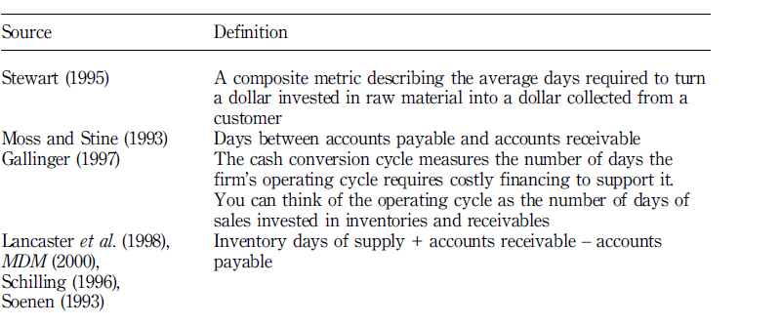
Cash –to- Cash : The new Supply chain Matric

Slide 10
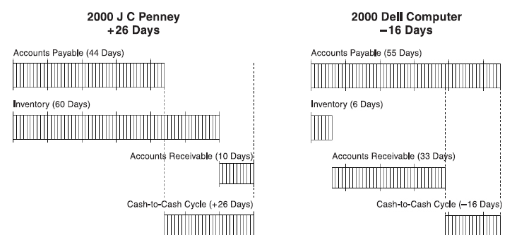
Positive vs. negative Cash to Cash

Slide 11
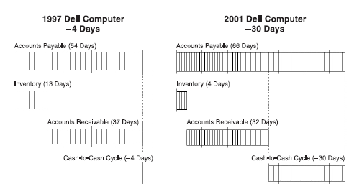
Positive vs. negative Cash to Cash

Slide 12
Importance of measuring C to C
Accounting Perspective – It helps in measuring liquidity and value.
One approach is static approach wherein traditional ratios such as current , quick etc. to assess liquidity.
Other approach is dynamic approach wherein on-going liquidity is judged from the firm’s operation. Here C to C is used. (Firstly introduced by Gitman & Sachdeva)

Slide 13
C to C
C to C helps in :
Evaluating changes in circulating capital.
In knowing the minimum level of liquidity and optimum level of liquidity.
Optimum liquidity position is ongoing trade – off between financial decisions to shorten the C to C cycle (decreasing minimum liquidity) and operational decisions (lengthen C to C cycle and increasing minimum liquidity )

Slide 14
C to C
Cash Turnover (365/cash cycle)
Dividing Cash Turnover into annual cash expense.
Higher the cycle – higher would be minimum liquidity and vice-versa.
Firm Valuation & C to C cycle
A shorter C2C cycle leads to higher present values of cash flows generated by the assets and so higher firm value.

Slide 15
Leverage points to manage C2C
Extend AP
Shorten Production cycle – ICP
Reduce AR
1. Extending AP – Free financing
Paying at last moment
Partial not full payment
Using interest free credit card

Slide 16
Shorten Production cycle – ICP Reduce AR
JIT
Accurate forecasting

Slide 17
Cash Forecasting & Budgeting
Cash planning and control is essential to avoid the situation of deficit or excess of cash as both case has negative impact on value maximizing process.
Cash planning is basically done on the basis of cash budget which is basically a projected statement of firm’s cash inflows and inflows during a given period.

Slide 18
CASH BUDGET
A Cash Budget is a summary statement of the firms’ expected cash inflows and outflows over a projected time period.
In other words, cash budget involves a projection of future cash receipts and cash disbursements over various time intervals.
While preparing cash budget seasonal factors must be taken into account and in practice cash budget is prepared on a monthly basis

Slide 19
Preparation of Cash Budget
Preparation of cash budget involves the following steps:
Selection of time horizon/period for which it has to be prepared.
Estimation of cash items involving the cash inflows and outflows .
Actual construction of cash budget where for the selected time horizon the cash inflows and outflows items are plotted and the excess or shortfall amount of cash is identified for the given period.

Slide 20
Some basic points considered while preparing cash budget
Payment of dividends, taxes etc., and the month in which such payments are to be made.
Non-consideration of non-cash transactions.
Minimum cash balance required and the amount of credit/overdraft limit allowed by the banks.
Plan to deal with cash surplus and cash deficit situations.
Debt repayment (time and amount).
Credit period allowed to debtors and the credit period allowed by creditors to the firm for goods and services.

Slide 21
Cash Budget
A cash budget helps the management in
(i) determining the future cash needs of the
firm,
(ii) planning for financing of the needs;
(iii) exercising control over cash & liquidity of the firm

Slide 22
Methods of Preparing Cash Budgets
There are basically three methods for preparing cash budgets.
1) Receipts and Payments Method
2) Adjusted Profit and Loss Account Method
3) Balance Sheet Method

Slide 23
Receipts and Payments Method
Here, all receipts are added and out of the total, the sum of all payments is deducted to arrive at the balance in hand.
The closing balance in hand say, for a particular month is the opening balance of the next month and is added to the total of receipts to know the total availability of cash during the month.
The receipts and payments during the budget period are found out from various functional budgets prepared.
The credit allowed to debtors, the credit got from suppliers, delay in payment of wages and other expenses etc. are considered to determine the timing of receipts and payments.
Advance payments and receipts are to be included but outstanding expense and accrued income are excluded from cash budget.
Revenue as well as capital receipts and payments are recorded in cash budget.

Slide 25
Managing cash collection and disbursement
Basically cash management seeks to have efficient collection and disbursement of cash and temporary investment of cash.
So cash management seeks to ensure its availability at the right time in right quantity and minimizing its idle balance.
In cash management the basic idea is to speed up the cash receipts and delay the cash payments as for as possible.

Slide 26
CASH COLLECTION & DISBURSEMENTS
Finance manager adopts basically two strategy for managing cash and that is expediting the cash collections and delaying the cash payments as for as possible.
In the above process he focus on the following floats:

Slide 27
1. Collection Float: In simple words it is the amount tied up in cheques and drafts that have been sent by the customers, but has not yet been converted into cash. The reasons for this type of collection float are:
• The time taken in postal transmission
• The time taken to process cheques and drafts by the company, and
• The time taken by banks to clear the cheques.
To reduce this float companies can use various techniques, which are as follows:

Slide 28
a) Concentration Banking: When the customers of the company are spread over wide geographical areas then instead of a single collection centre the company opens collection centres at the regional level. The customers are instructed to remit payments to their specific regional centres. These regional centres will open bank accounts with the branches of banks where it has collection potential. These branches will telegraphically or electronically transfer the collected amount to the Head Office bank account. This system accelerates cash inflows.

Slide 29
b) Lock Box System: In this system, the customers are advised to mail their payments to a post office box hired by the firm for collection purposes near their area. The payments are collected by local banks who are authorised to do so. They credit the payments quickly and report the transaction to the head office.

Slide 30
c) Zero Balance Account: In this type of account any excess cash is used to buy marketable securities. Excess cash is the balance remaining after the cheques presented against this account are cleared. In case of shortage of cash marketable securities are sold to replenish cash.
d) Electronic Fund Transfer: Through electronic fund transfer the collection float can be completely eliminated the other benefit of electronic fund transfer is instant updation of accounts and reporting of balances as and when required without any delay.

Slide 31
2. Payment Float: The time gap between Cheques issued for payment and actually presented in the bank for clearing is called payment float. Companies can estimate this float on the basis of scientific cheques cashing analysis and past trends and the company can use this phenomena by keeping funds only to the extent of the amount of cheques which will be presented. The company should be very careful in playing this float in view of stringent provisions regarding the dishonoring of cheques, loss of reputation etc.

Slide 32
INVESTING SURPLUS CASH
Treasury Bills
Commercial Papers
Certificate of Deposits
Bank Deposits
Inter-corporate Deposit
Money Market Mutual Funds
Call Market

Slide 33
The five basic tenets of cash management
BILL PROMPTLY
FOLLOW UP AGGRESSIVELY
PAY SLOWLY.
INVEST DISCRETELY

